Slide 1
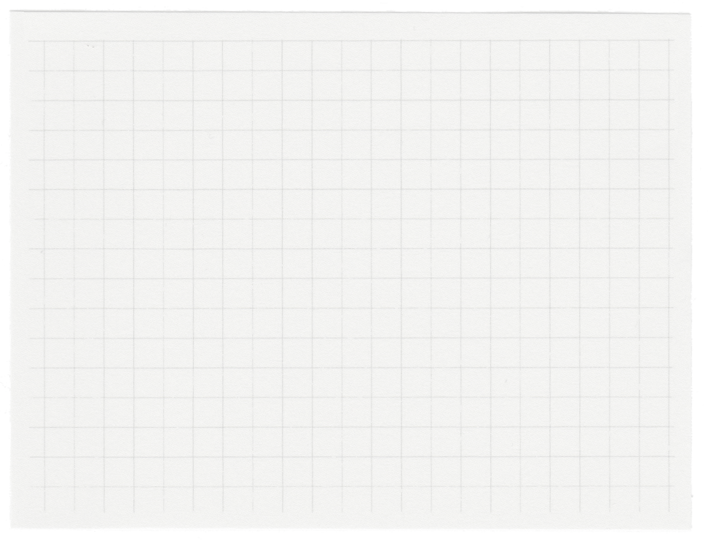
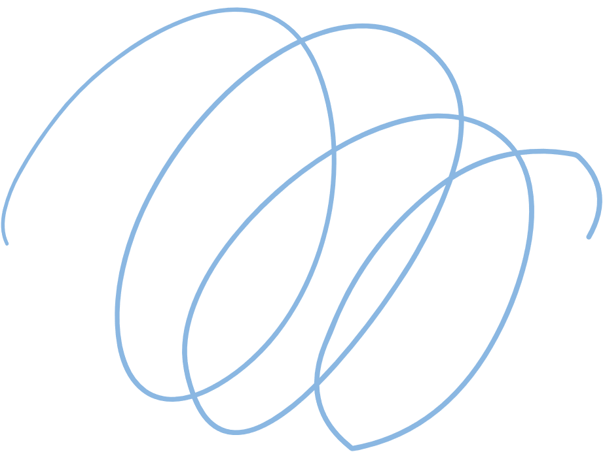













Money Mate
Developed By: Muhammad Yaqoob
Client: Huzaifa Mumtaz

Slide 2
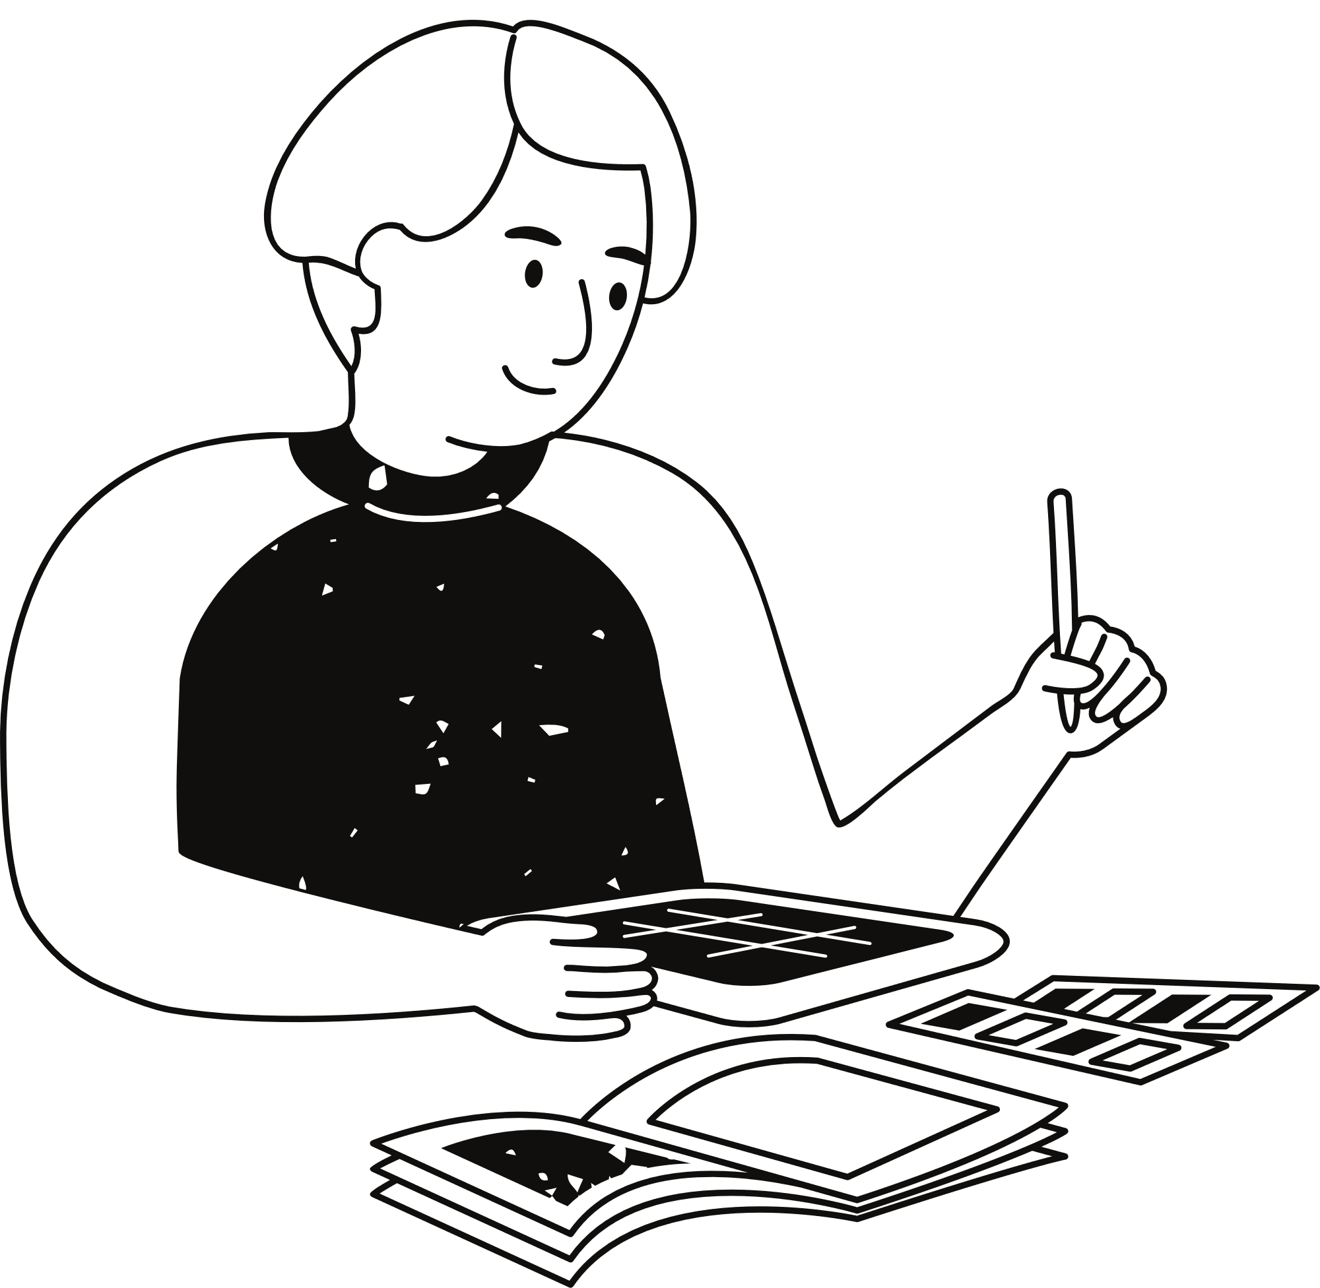
Project Description
Split expenses with friends, roommates, group trips, and more.
MoneyMate is a convenient app that helps you easily split bills and expenses with friends, roommates, or anyone you share expenses with. It keeps track of who owes what, simplifies
The process of splitting bills, and ensures everyone gets paid back accurately

Slide 3
Project Features
01
02
03
04
Authentication
Authorization
Crud Opeations of User
Crud Operations of Friend
Crud Opeations of Groups
Activity
Record of Payments

Slide 4
01.
Cross-Platform Development
Rich User Interfaces
Performance
Framework
Flutter for frontend
Node js for backend
02.
JavaScript Everywhere
NPM Ecosystem
Community Support

Slide 5
External Libraries
http
body-parser
Hypertext Transfer Protocol
It provides four express middleware for parsing JSON, Text, URL-encoded, and raw data sets over an HTTP request body.
moongooes
Mongoose acts as a front end to MongoDB, an open source NoSQL database that uses a document-oriented data model.
express
jsonwebtoken
It's a layer built on the top of the Node js that helps manage servers and routes. It is used to build a single page, multipage, and hybrid web application.
Securely transmitting information between parties as a JSON object. This information can be verified and trusted because it is digitally signed.

Slide 6
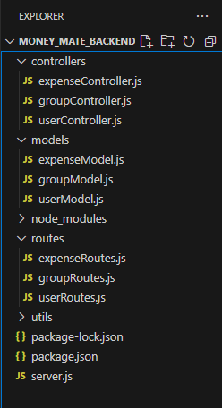
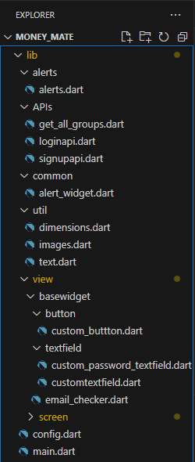

Project Structure
Naming Convensions

Slide 7
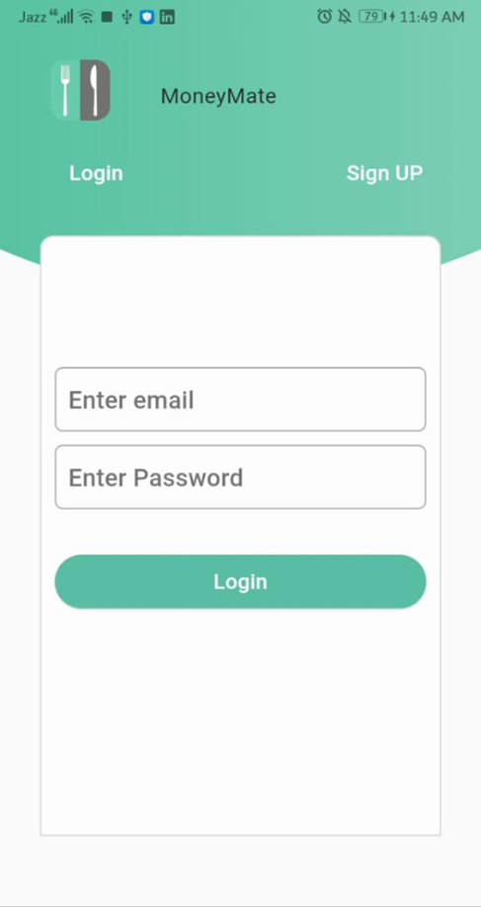
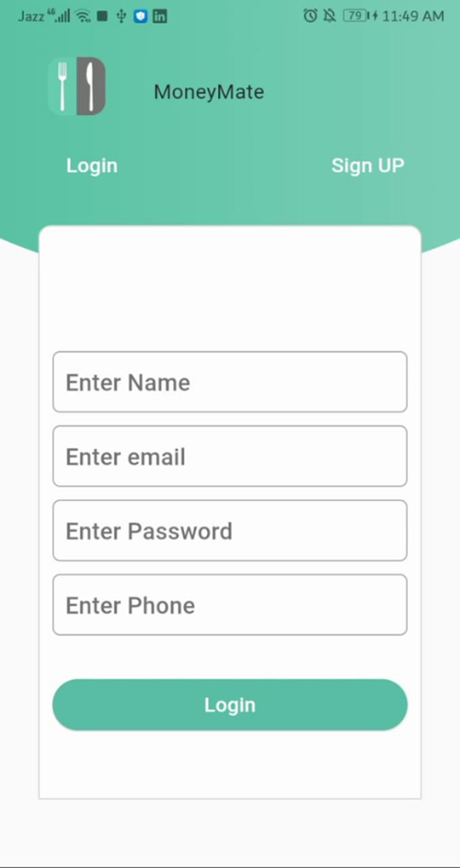
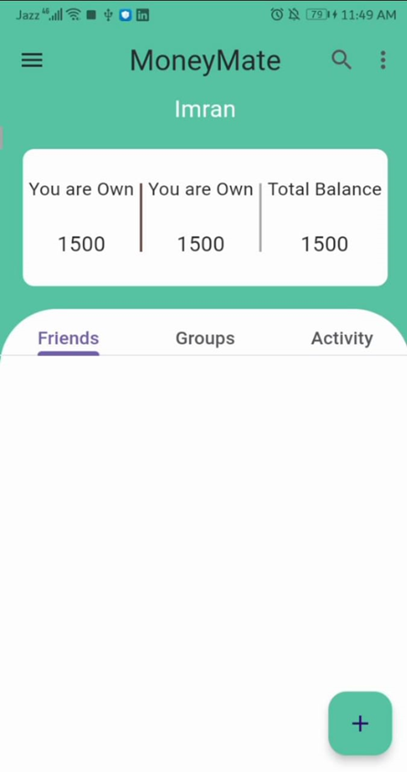
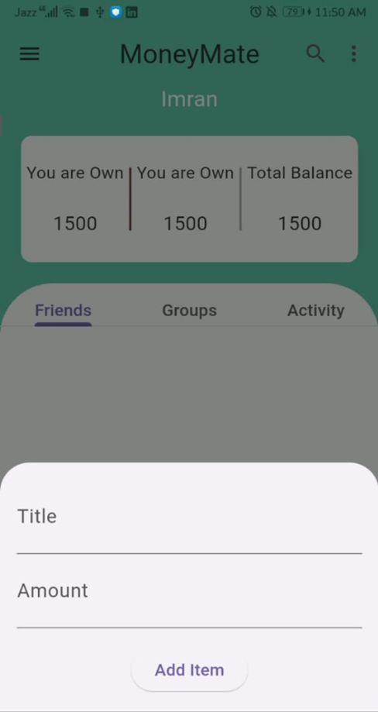
Wireframes

Slide 8
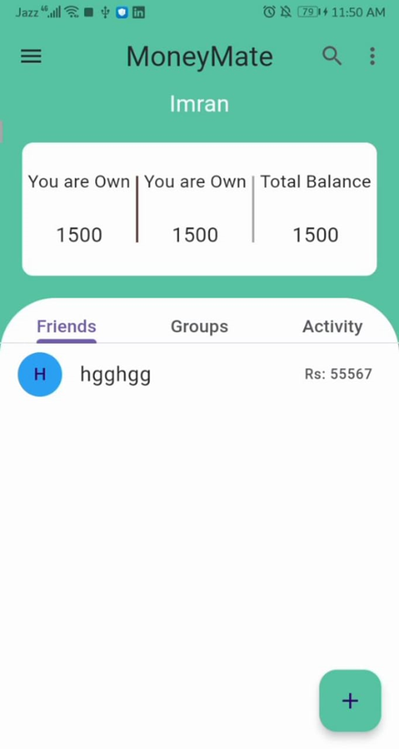
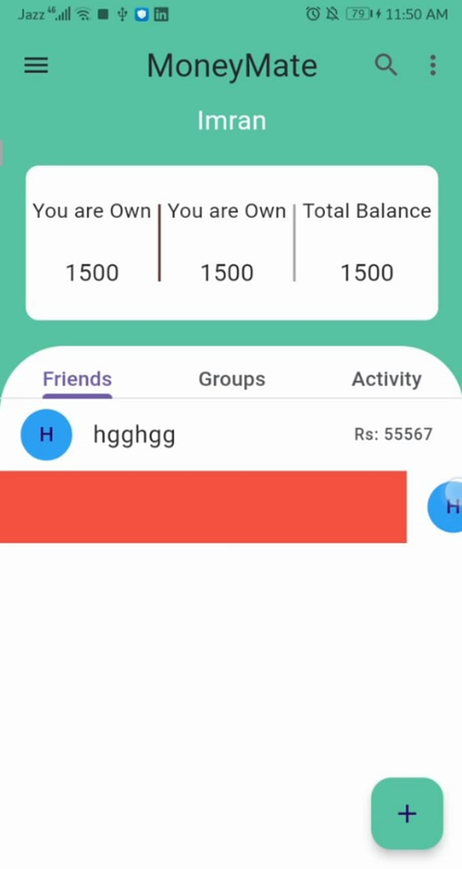
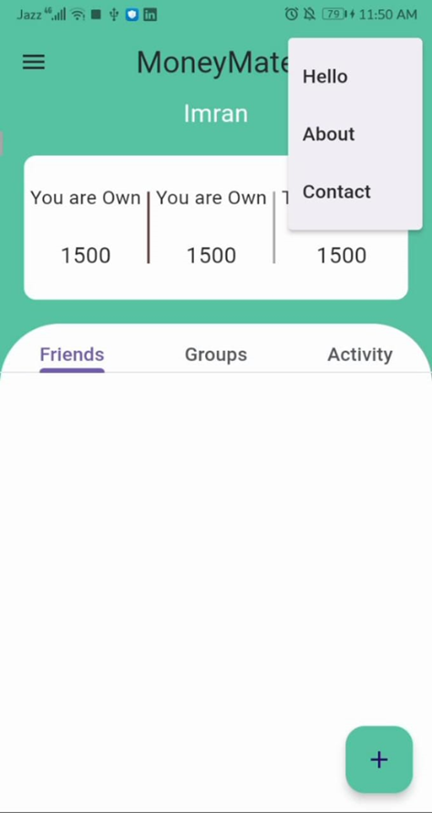
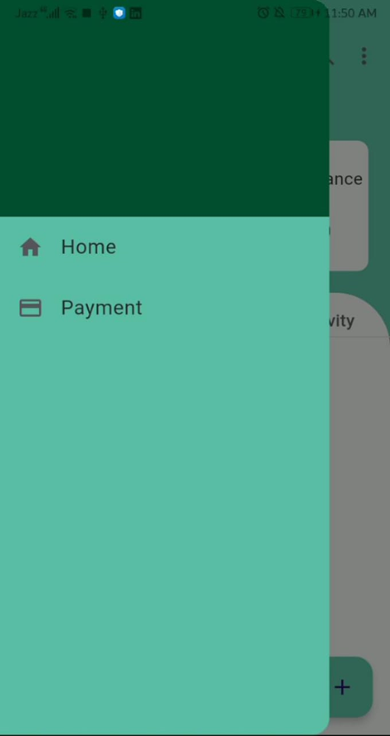
Wireframes

Slide 9
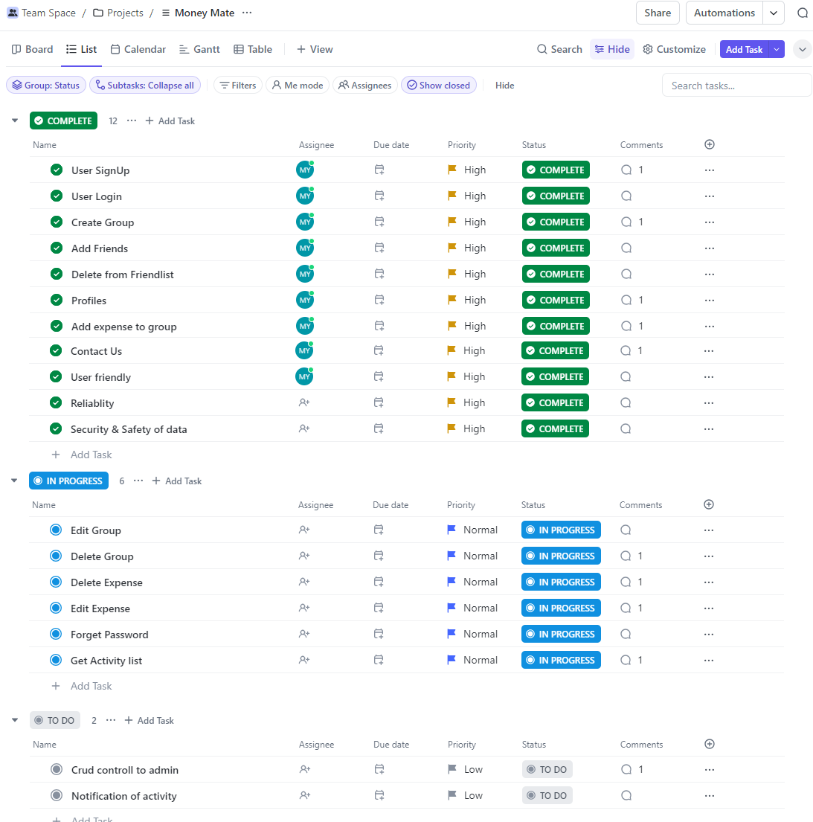
Project Management Tool - CLICK UP

Slide 10
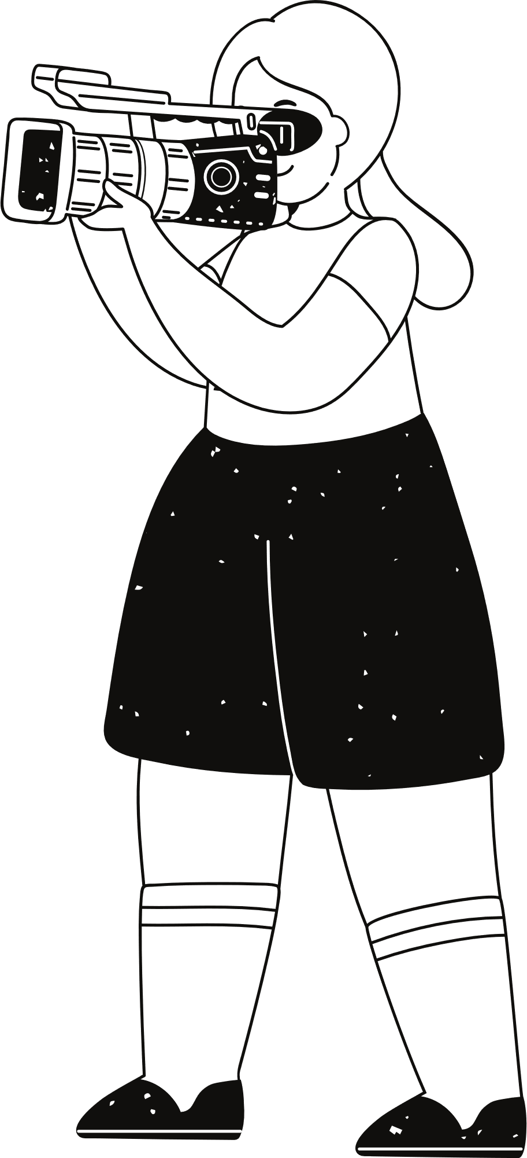
Meeting Minutes
Meeting 1
Meeting 2
Define and finalize the functional requirements for the moneymate project, ensuring clarity on user roles, system features, and functionalities of user
Aimed to show and discuss the figma design of money mate app.
Meeting 3
Meeting 4
Aimed to show and discuss half of the functionalities of money mate that is: signup, login, add friend, add group, add expense
Aimed to showcase the project.
Showing features of the project and confirm the project

Slide 11
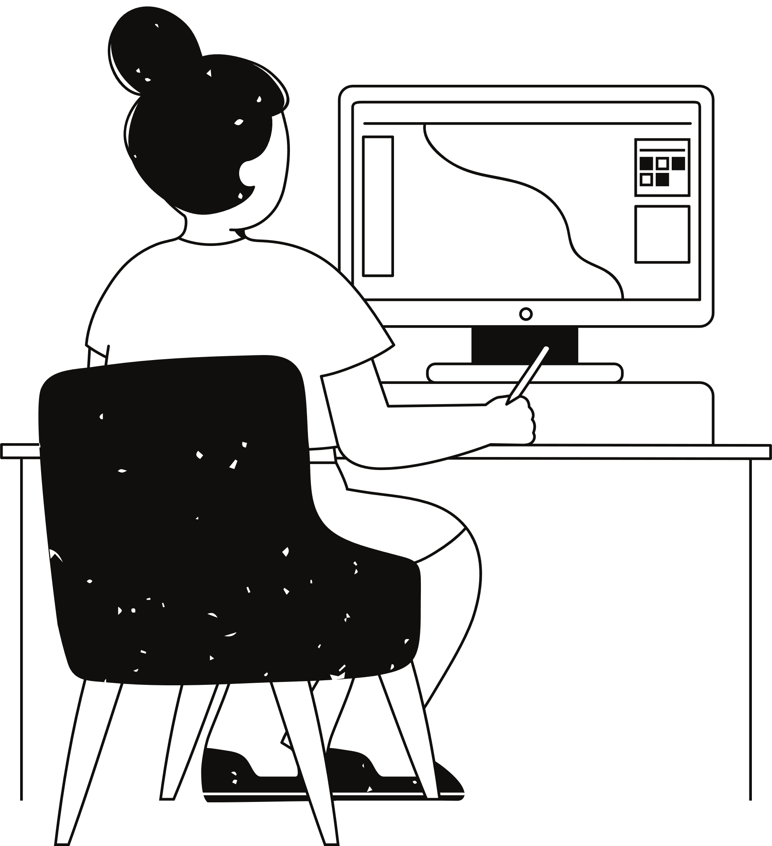
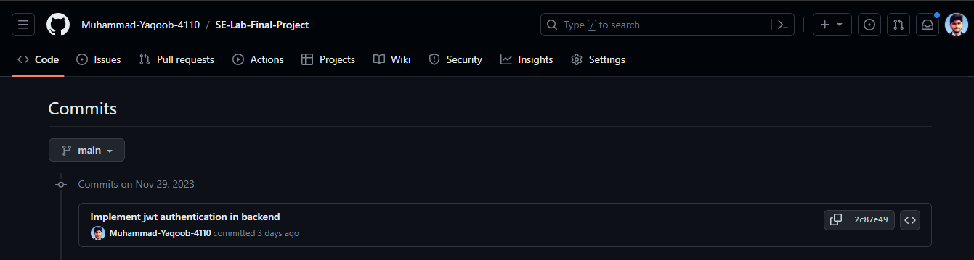
GitHub
Commits

Slide 12
Thank you very much!
2021cs118@student.uet.edu.pk

